Slide 1

Editor’s Report
Monica Fabiani
Editor in Chief
Psychophysiology
mfabiani@Illinois.edu

Slide 2
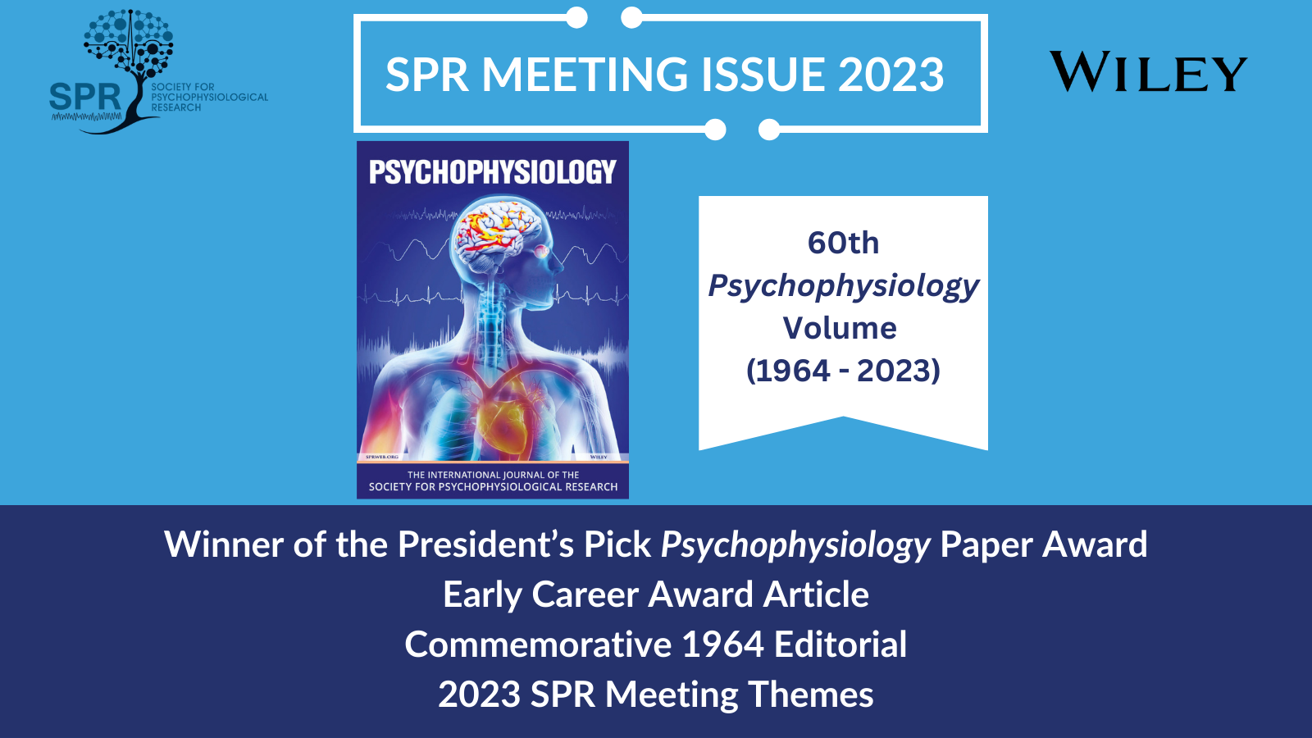
https://onlinelibrary.wiley.com/doi/toc/10.1111/(ISSN)1469-8986.spr-meeting-2023

Slide 3
Submissions – past 20 years
2018=450
2019=542
2020=653
2021=672
2022=711
2023 =711
Notes:
Submissions were rock solid at 400 between 2009 and 2017, but since then they have been increasing, reaching 450 in 2018 and 542 last year. This year they are continuing to grow, and we are projecting a total of about 650 for 2020.

Slide 4
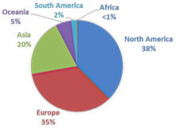
Geography of Submissions: 2015 vs. 2022
2015
2022
Notes:
We are also experiencing some geographic diversification, with submissions from Asia and more specifically from China showing a growth, but also seeing a growth in submissions from many other countries, grouped here under others

Slide 5
Measures : 2015 vs. 2022
2015
2022
Notes:
The content and method keywords are consistent with previous years – we continue to publish broad content using a large array of methodologies

Slide 6
Gender and Membership: Last 13 years
Notes:
SPR members continue to be a minority of our growing authors. With respect to first author gender, we continue to be close to 50$. However, this is a number to monitor as it seems that women, and especially those with daycare- and school-age children are particularly impacted by the CPVID 19 pandemic

Slide 7
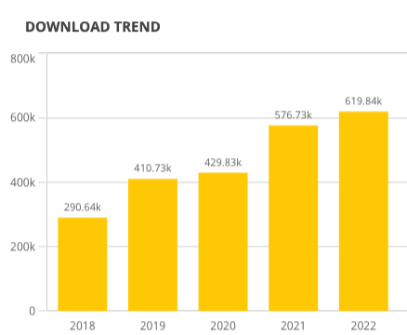
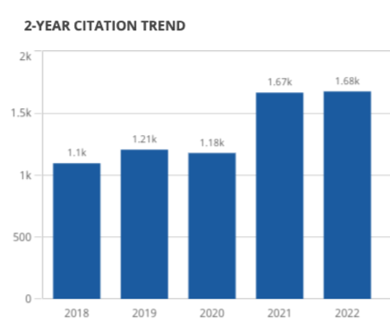
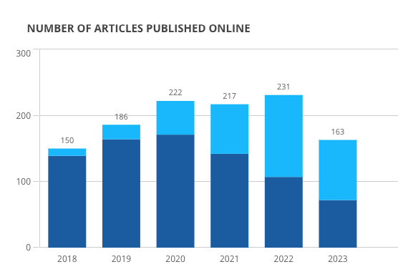
open access (OA)
Data for 2023 = end of August

Slide 8
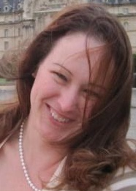
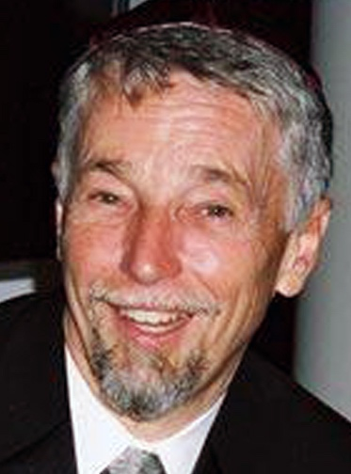

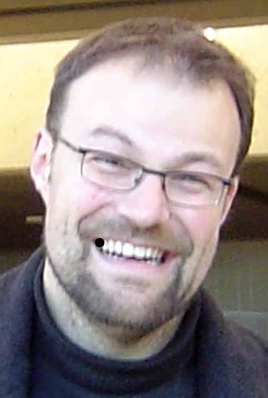
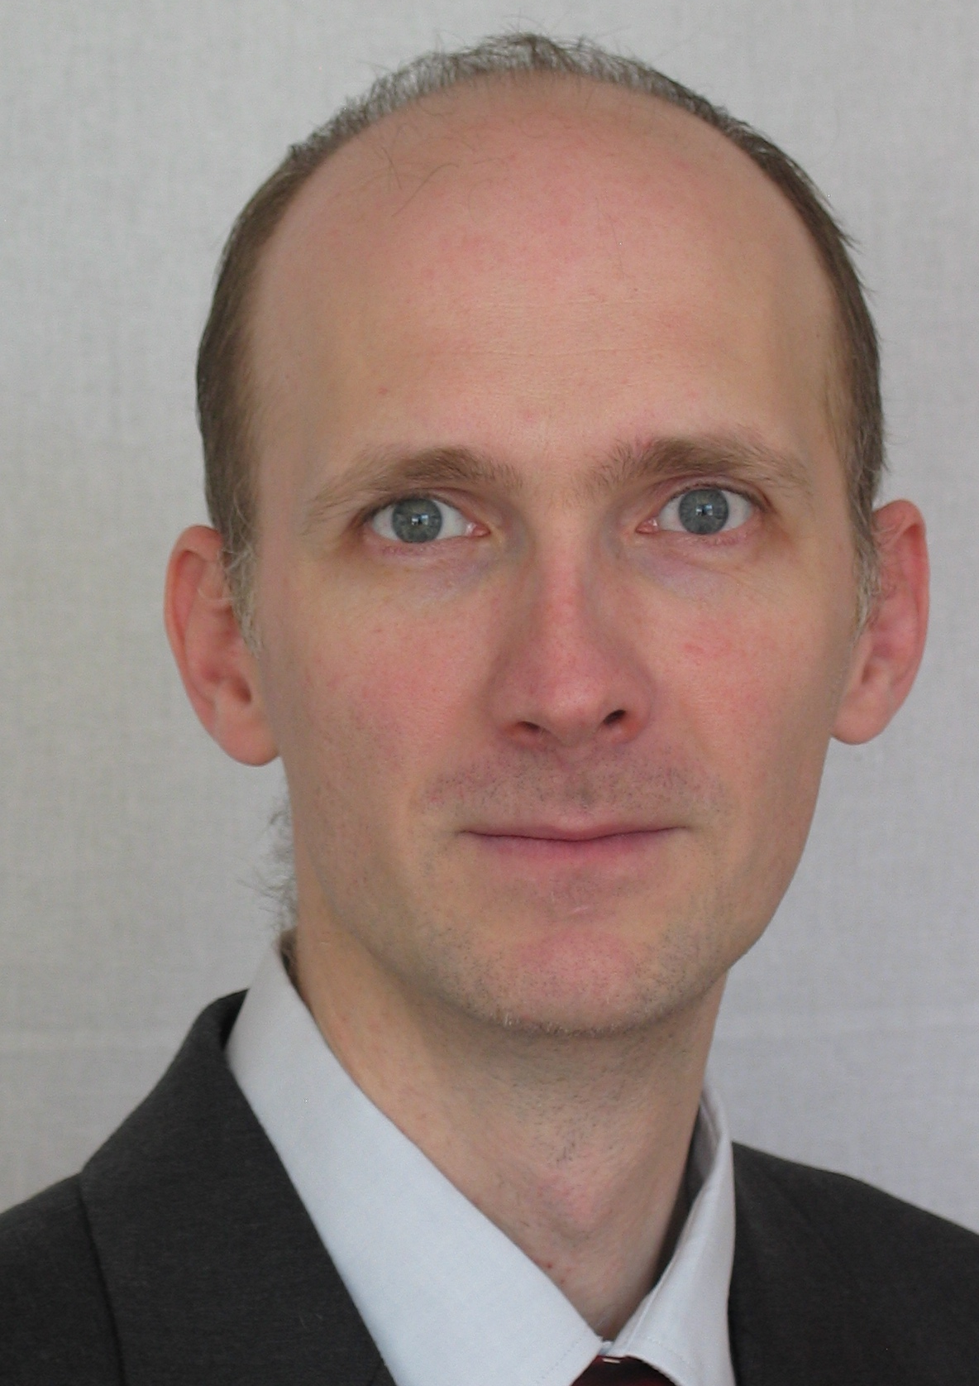
Editorial Board: Senior Editors
Lisa Gatzke-Kopp
Bruce Bartholow
Dick Jennings
Janòs Horvath
Andreas Keil
Notes:
As you can imagine, this increase in submissions has necessitated some changes in the way the journal is structured. In the summer of 2019 we added 3 senior editors,{NAMES]. Because of the continuing growth, in January 2020 we added a fourth SE, JH.
The SEs help with triaging and assigning the manuscripts and are also involved in other aspects of journal running. We are truly indebted to them for their dedication and efforts

Slide 9
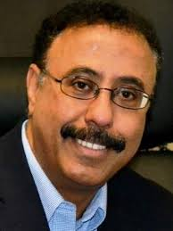
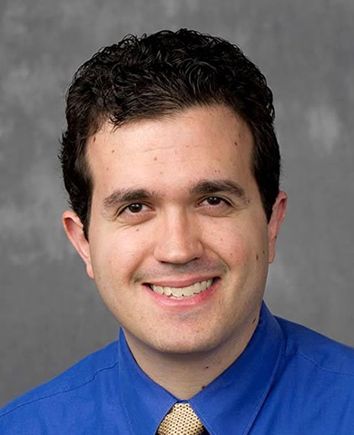
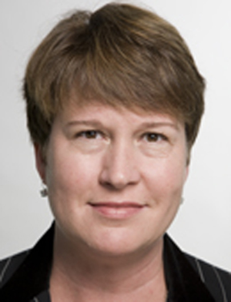
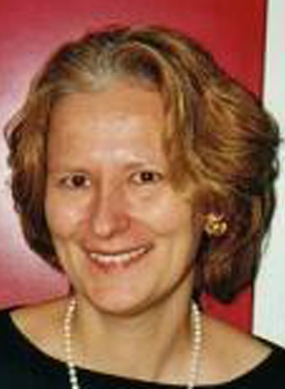
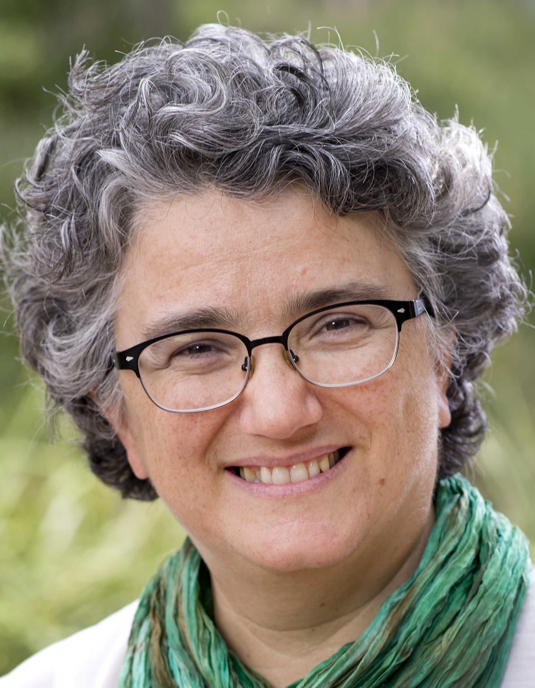
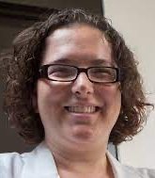
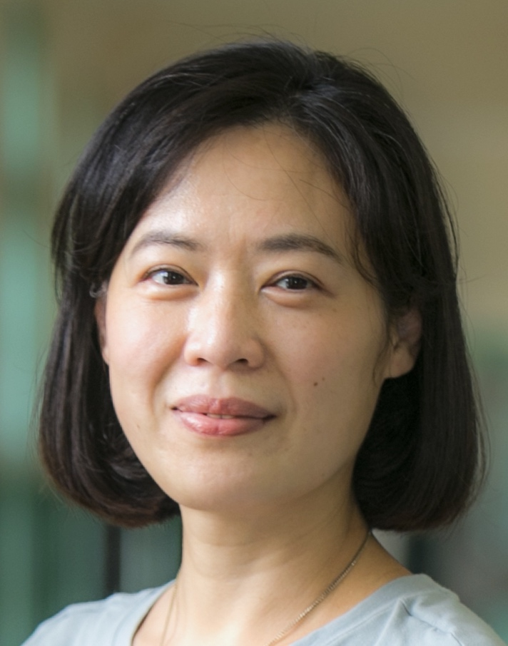
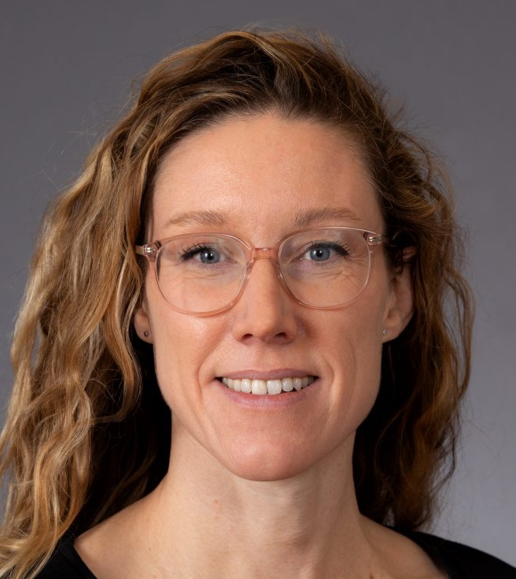

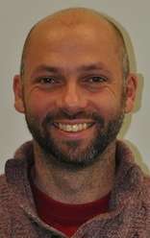
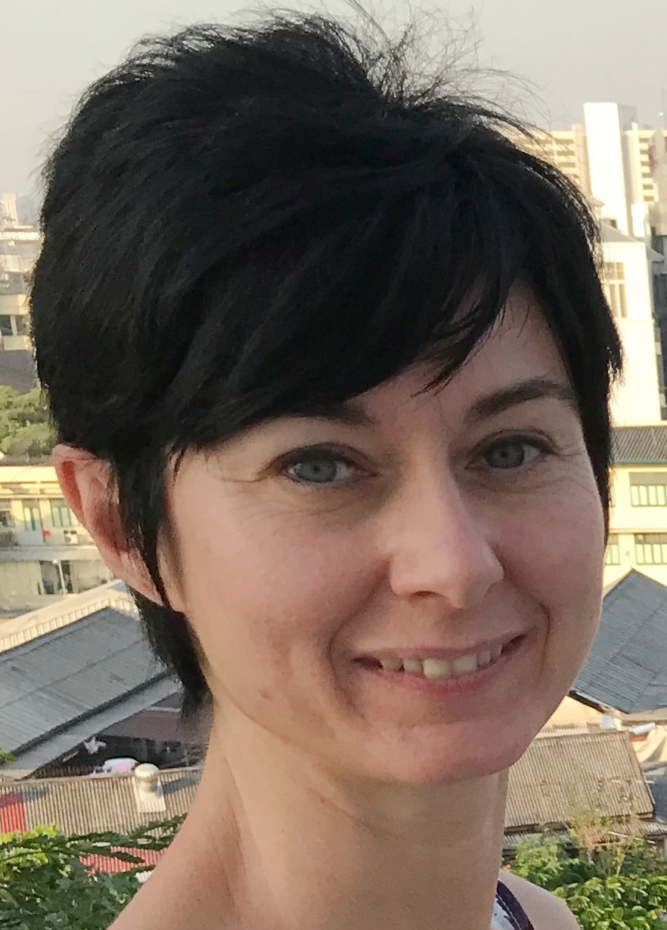

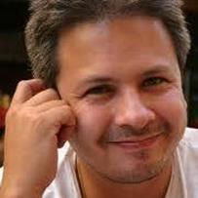
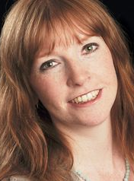
Psychophysiology: Associate Editors (2023)
Mustafa al’Absi
Dan Foti
Brian Gordon
Erin Hazlett
Ursula Hess
Frini Karayanidis
Annmarie
MacNamara
Stephan Moratti
Sarah Laszlo
Chia-Lin Lee
John McDonald
Sander Nieuwenhuis
Cristina
Ottaviani
Ilse Van Diest
Nathan Weisz
Anna Whittaker
Notes:
Of course the journal would not function without many dedicated Associate Editors, who handle manuscripts, select reviewers and provide recommendations

Slide 10
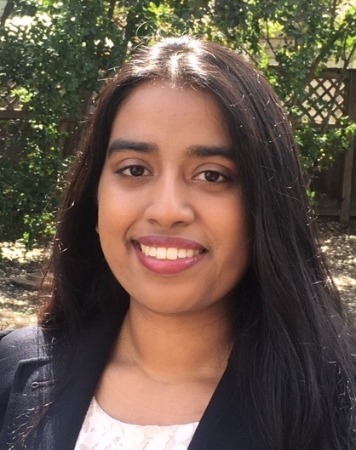
Editorial office
Samia Islam
Notes:
The increase in submission has also brought an increase workload to the editorial assistants. Many of you may have met Grace Clements, who was serving as a 50% Editorial assistant trhough 2019. In January 2020 we split the 50% position into 2 35% positions, for a net increase of 20%. I would like to introduce Daniel Bowie, who is now working with Grace as an Editorial Assistant. A big thanks to both, who truly keep the journal running smoothly

Slide 11
Consulting Editors
Julian Koenig, Heidelberg University, Germany
Yasunori Kotani, Tokyo Institute of Technology, Japan Jutta Kray, Saarland University, Germany Olave Krigolson, University of Victoria, Canada Jennifer Kubota, New York University, USA Peter Lang, University of Florida, USA Christine Larson, University of Wisconsin – Milwaukee, USA Sheng Li, Peking University, China Ottmar Lipp, Curtin University, Australia Sebastian Ludyga, University of Basel, Switzerland Hiroaki Masaki, Waseda University, Japan Kyle Mathewson, University of Alberta, Canada Patricia T. Michie, University of Newcastle, Australia Gregory A. Miller, University of California, Los Angeles, USA Jeff Miller, University of Otago, New Zealand Jason Moser, Michigan State University, USA Brady Nelson, Stony Brook University, USA Nathan Parks, University of Arkansas, USA Christopher Patrick, Florida State University, USA Trevor Penney, The Chinese University of Hong Kong, China Daniela M. Pfabigan, University of Oslo and Vestfold Hospital Trust, Norway Matthew Pontifex, Michigan State University, USA Karen Quigley, Northeastern University, USA Nicola Sambuco, University of Bologna, Italy Anna Schubö, Philipps-University Marburg, Germany Jennifer Stewart, City University of New York, USA Julian Thayer, The Ohio State University, USA Anton Van Boxtel, Tilburg University, The Netherlands Rolf Verleger, University of Luebeck, Germany Scott Vrana, Virginia Commonwealth University, USA Anna Weinberg, McGill University, Canada Mathias Weymar, University of Potsdam, Germany Cindy Yee-Bradbury, University of California, Los Angeles, USA
Consulting Editors John Allen, University of Arizona, USA Pamela Baess, University of Hildesheim, Germany Francisco Barcelo, Universitat Illes Balears, Spain Gershon Ben-Shakhar, The Hebrew University of Jerusalem, Israel Gary Berntson, The Ohio State University, USA Terry Blumenthal, Wake Forest University, USA Lauren Bylsma, University of Pittsburgh, USA Donna Coch, Dartmouth College, USA Rebecca Compton, Haverford College, USA Paul Corballis, University of Auckland, New Zealand Seana Coulson, University of California, San Diego, USA Elise Dan-Glauser, University of Lausanne, Switzerland Danielle Dickson, University of Texas at San Antonio, USA Connie Duncan, Uniformed Services University of the Health Sciences, USA Elizabeth Duval, University of Michigan, USA Nicola Ferdinand, Saarland University, Germany Judith Ford, University of California, San Francisco, USA Frances Gabbay, Uniformed Services University of the Health Sciences, USA Courtney Gallen, University of California, San Francisco, USA Susan Girdler, University of North Carolina at Chapel Hill, USA Diane Gooding, University of Wisconsin-Madison, USA Stephanie Gorka, The Ohio State University, USA Gabriele Gratton, University of Illinois at Urbana-Champaign, USA Steven Hackley, University of Missouri – Columbia, USA Alfons Hamm, University of Greifswald, Germany Eddie Harmon-Jones, The University of New South Wales, Australia Johannes Hewig, Julius-Maximilians-Universität Würzburg, Germany Phillip Holcomb, San Diego State University, USA Emily Kappenman, San Diego State University, USA Motohiro Kimura, National Institute of Advanced Industrial Science and Technology, Japan
Notes:
inally, we are also indebted to our consulting editors who provide many expert reviews for the journal

Slide 12
Thanks also to:
Annmarie MacNamara and the SPR PR Committee
Susan Rees and the Rees Group
Ashley Haan
Mary Johns
Cindy Yee-Bradbury and SPR Publication Committee
Our Wiley partners
The SPR Officers and Board of Directors

Slide 13
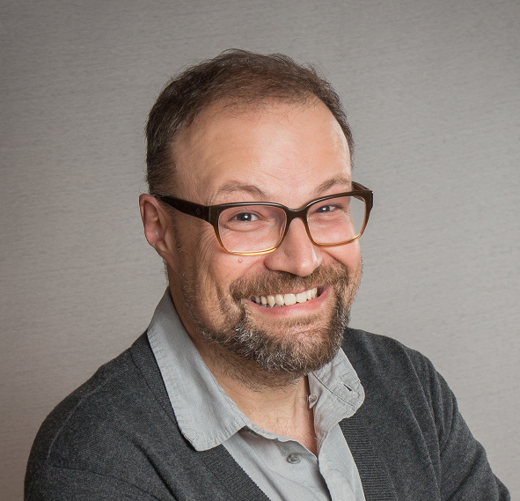
Andreas Keil
Editor in Chief, 2024

Slide 14


